Slide 1

4. Gears
Design 2
AENG21350
Department of Aerospace Engineering
University of Bristol

Slide 2
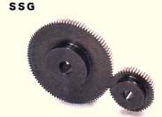
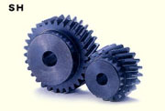
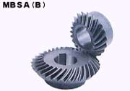
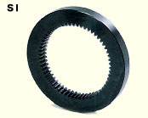
4.0 General concepts on gears
Spur gears
Helical gears
Internal spur gears
Bevel gears
Notes:
AENG11301 - Aeronautics and Mechanics

Slide 3
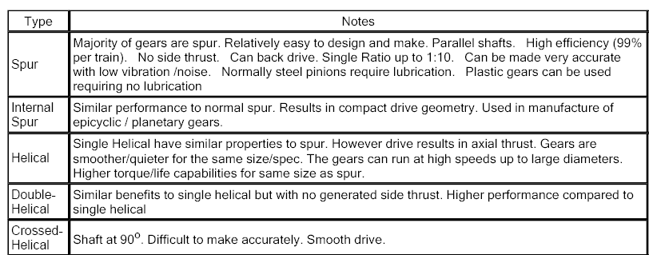
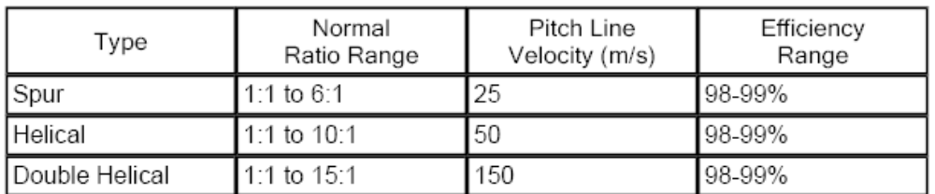
4.0 General concepts on gears
Notes:
AENG11301 - Aeronautics and Mechanics

Slide 4
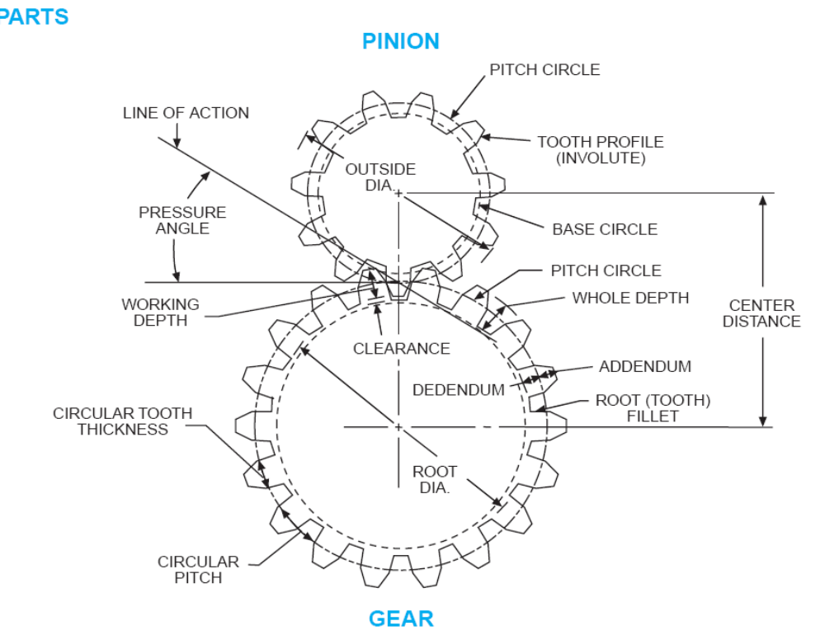
4.1 Spur Gears
Nomenclature:
GEAR = machine part with gear teeth. When two gears run together, the one with the larger number of teeth is called the gear.
CIRCULAR PITCH (p) = distance along the pitch circle or pitch line between corresponding profiles of adjacent teeth.
ADDENDUM (a)= height by which a tooth projects beyond the pitch circle or pitch line
DEDENDUM (b) = depth of a tooth space below the pitch line. It is normally greater than the addendum of the mating gear to provide clearance.
BASE DIAMETER (Db) = the diameter of the base cylinder from which the involute portion of a tooth profile is generated.
Notes:
AENG11301 - Aeronautics and Mechanics

Slide 5
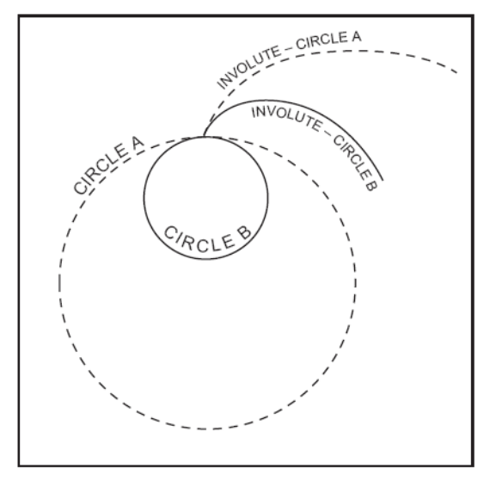
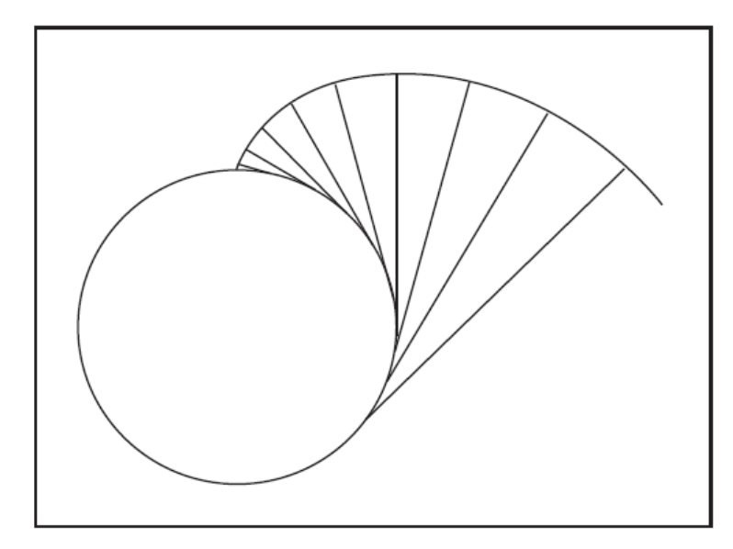
4.1 Spur Gears
Gear teeth could be manufactured with a wide variety of shapes and profiles. The involute profile is the most commonly used system for gearing today.
An involute drawn from a larger base circle will be less curved (straighter) than one drawn from a smaller base circle. ← → the involute tooth profile of smaller gears is considerably curved, on larger gears is less curved (straighter), and is straight on a rack, which is essentially an infinitely large gear.
An involute is a curve traced by a point on a taut cord unwinding from a circle (BASE CIRCLE). The involute is a form of spiral, the curvature of which becomes straighter as it is drawn from a base circle and eventually would become a straight line if drawn far enough.
Notes:
AENG11301 - Aeronautics and Mechanics

Slide 6
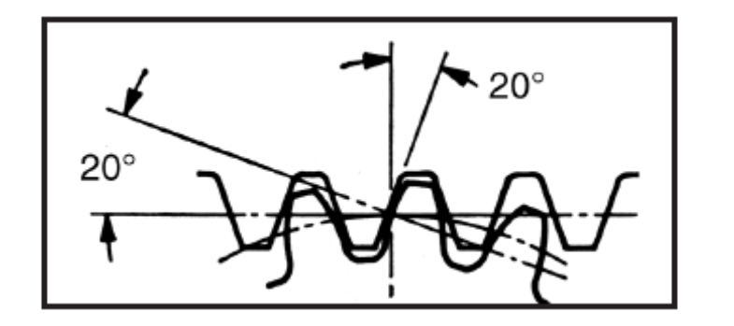
4.1 Spur Gears - guidelines
Gears are most often used in transmissions to convert a motor’s high speed and low torque to a shaft’s requirements for low speed high torque.
If the motor is electric:
– Speed → easy to generate, (voltage is easy to generate)
– Torque → difficult to generate because it requires large amounts of current
Gears allow positive engagement between teeth so high forces can be
transmitted while still undergoing essentially rolling contact.
– Gears do not depend on friction and do best when friction is minimized
Basic Law of Gearing:
– A common normal (the line of action) to the tooth profiles at their point of contact must, in all positions of the contacting teeth, pass through a fixed point on the line-of-centers called the pitch point
– Any two curves or profiles engaging each other and satisfying the law of gearing are conjugate curves, and the relative rotation speed of the gears will be constant
Pressure angle is the angle at a pitch point between the line of pressure which is normal to the tooth surface, and the plane tangent to the pitch surface. The pressure angle refers to the angle when the gears are mounted on their standard center distances. 20° → high load carrying capacity; 14.5° → less sensitivity to eccentricity, less noise, high contact ratio.
Notes:
AENG11301 - Aeronautics and Mechanics

Slide 7
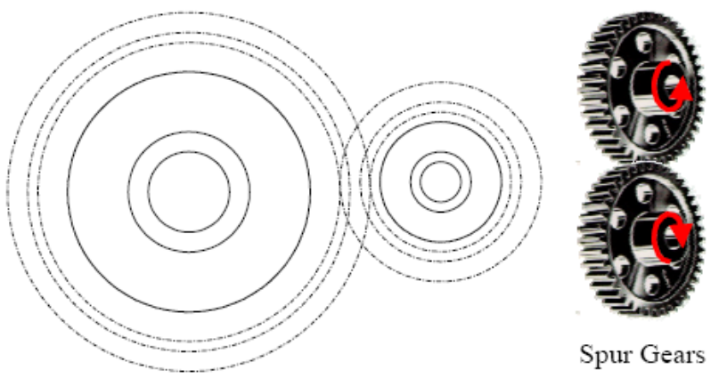
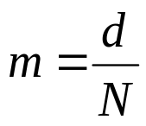
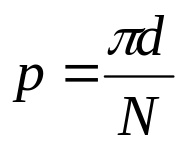
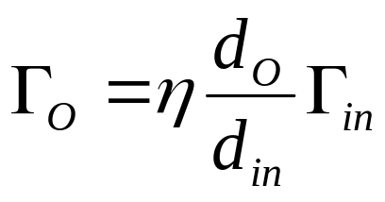
4.1 Spur Gears - guidelines
Pinion: smaller of two gears (typically on the motor) drives a gear on the output shaft
Gear or Wheel: Larger of the two gears
m = module (mm)
d = pitch diameter (mm)
N = number of teeth
p = circular pitch (mm)
By conservation of energy:
Γ_{O} = torque output
Γ_{in} = torque in
d_{O} = out pitch diameter
d_{in} = in pitch diameter
η = efficiency (~ 95 %)
Notes:
AENG11301 - Aeronautics and Mechanics

Slide 8
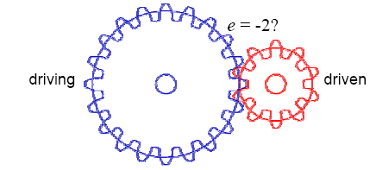

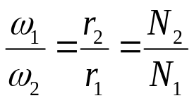
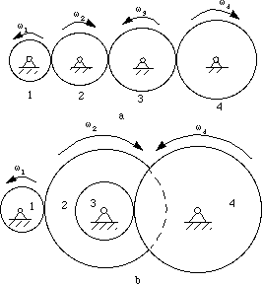

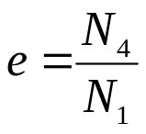
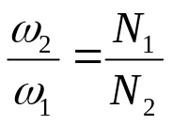
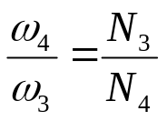
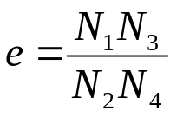
4.1 Spur Gears trains
When 2 gears are in mesh, their pitch circles roll on one another without slipping
Product of driving tooth numbers
e = ____________________________
Product of driven tooth numbers
Case a.
(-)*
Case b.
(+)*
Intermediate gear is idler
*(Sign convention assumed in US and few international manuals and textbooks: see Schmid S R, Iamrock B J and Jocobson B O. Fundamentals of Machine Elements, 3rd Edition: SI Edition. CRC Press, Boca Raton FL, 2014)
Notes:
AENG11301 - Aeronautics and Mechanics

Slide 9
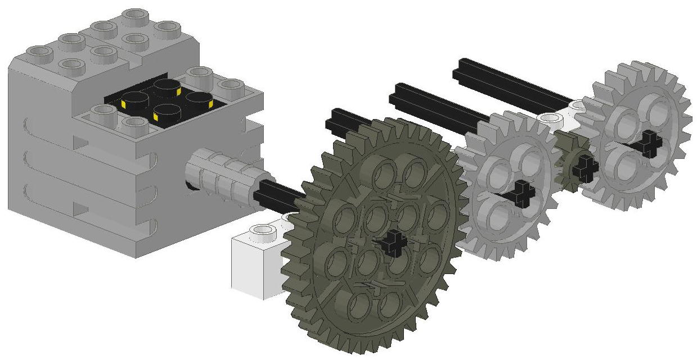
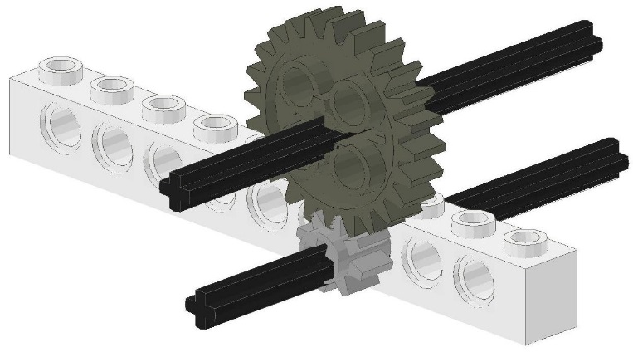
4.1 Spur Gears trains
To analyze any gear train one needs to:
Locate the driver gear (see force applied)
Locate the follower gear (see where useful work done)
Identify if it is geared up or geared down (big diameter turning small diameter – geared up)
Calculate the Gear Ratio using the following 3 rules for calculation:
Driver
Follower
Idler
Follower
Driver
Long Gear Trains
Pair-up gear
Driver is driven by the motor, driven does the work
Driver is one connected to applied force, follower is the last one in the gear train. All others idlers
Notes:
AENG11301 - Aeronautics and Mechanics

Slide 10
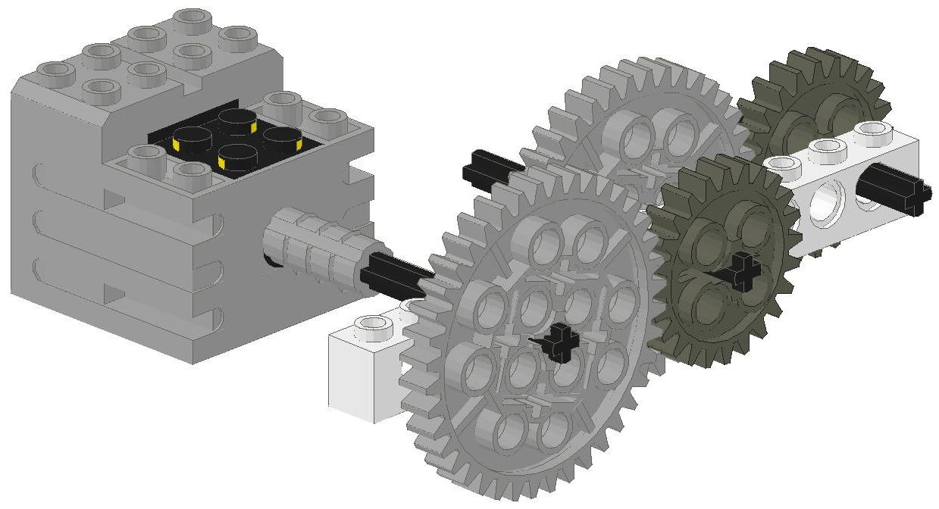
4.1 Spur Gears trains
Compound Gears
D2
F2
Pair up as many drivers and followers and label them D1, F1, D2, F2, etc.. Every time you follow an axle and it has a second gear attached → start a new driver. Multiply the gear ratios of all pairs of driver-follower
F1
D1
Possible gear Configurations other than 1:1 ratios:
24t & 40t spur gives 3:5 or 5:3
24t & 8t spur gives 1:3 or 3:1
Notes:
AENG11301 - Aeronautics and Mechanics

Slide 11
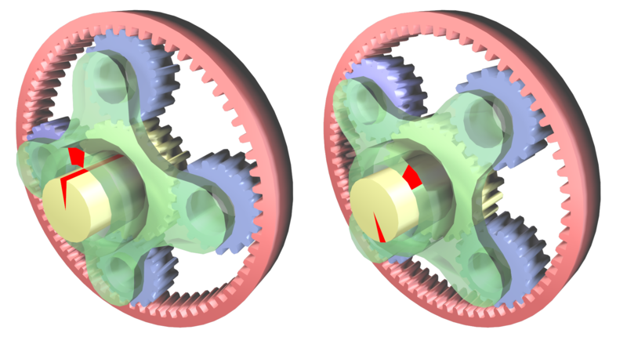
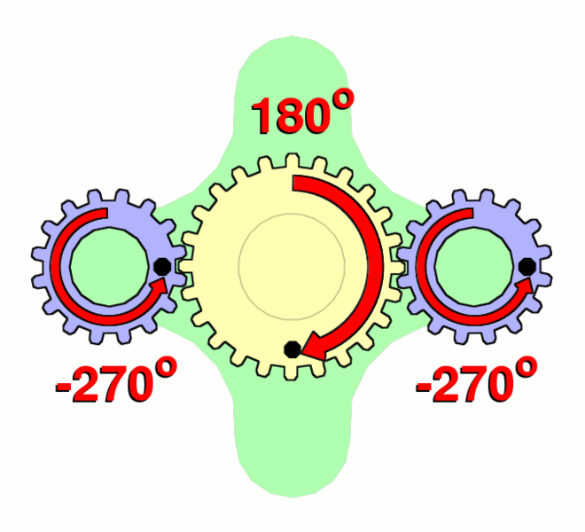
4.2 Epicyclical gears
Epicyclic gearing or planetary gearing is a gear system consisting on:
one or more outer gears, (planet gears)
a central, or sun gear, around which the outer gears rotate.
Planet gears are mounted on a movable arm (carrier) which itself may rotate relative to the sun gear.
Epicyclic gearing systems may also incorporate the use of an outer ring gear (annulus), which meshes with the planet gears
http://en.wikipedia.org/wiki/Image:Epicyclic_gear_ratios.png
The carrier (green) is held stationary while the sun gear (yellow) is used as input. The planet gears (blue) turn in a ratio determined by the number of teeth in each gear.
Notes:
AENG11301 - Aeronautics and Mechanics

Slide 12
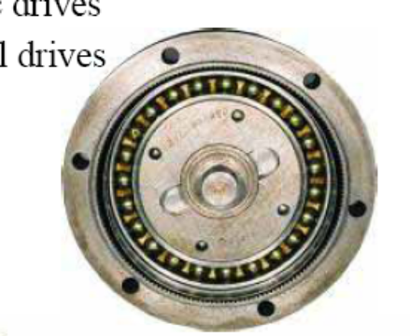
4.2 Epicyclical gears
One of the 3 basic components is held stationary;
One of the two remaining components is an input, providing power to the system
The last component is an output, receiving power from the system.
The ratio of input rotation to output rotation is dependent upon the number of teeth in each gear, and upon which component is held stationary
Example. Planetary carrier is held stationary (g), sun gear is used as input (y – S teeth). The planet gears (blue – P teeth) turn in a ratio determined by the number of teeth in each gear.
However, if one blocks the anulus, with input provided to the planetary gear carrier; output rotation is then produced from the sun gear → different output ratio
- S/P
Notes:
AENG11301 - Aeronautics and Mechanics

Slide 13

4.2 Epicyclical gears – table method
Sun
Arm
Planet
Actions | Arm turns | Planet turns | Sun turns
With all moving parts locked, the entire assembly is given one positive turn (CCW).
With the arm fixed, the sun is given one negative turn (CW).
Add the above two values to obtain the RESULTANT TURNS.
+ 1
+ 1
+ 1
0
-1
+1
+4
0
Notes:
AENG11301 - Aeronautics and Mechanics

Slide 14
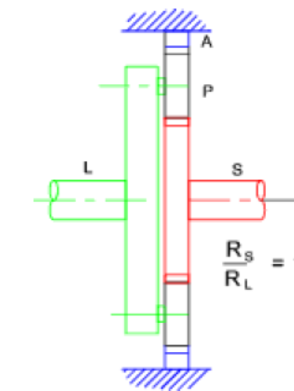
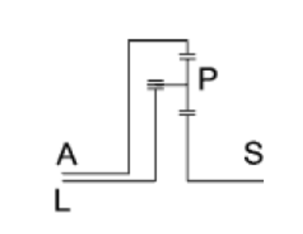




4.2 Epicyclical gears – table method
Rotation of the planet shaft (L) 1 rev CW results in the rotation of the shaft (S) 1 + N_{A} / N_{S} revs (CW). Ratio 1 : ( 1 + N_{A} / N_{S} )
A fixed
Actions | L | A | P | S
Give one CW rotation to whole gear
Fix arm L and rotate A back 1 CCW
Resultant
+1
+1
+1
+1
0
-1
+1
0
Notes:
AENG11301 - Aeronautics and Mechanics
In second row, A is given a -1 rotation to make it fixed at the end (it opposes the +1 rigid body rotation imparted to the whole gear system). Transmission between A and P is positive (A is an external ring), multiplied by the -1 of the rotation of A gives – NA/NP. L is fixed, therefore the rotation of A leads to a direct rotation of S. Transmission between A and S is positive, because A is an external gear (see the sign convention referenced in slide #8) → NA/NS.

Slide 15
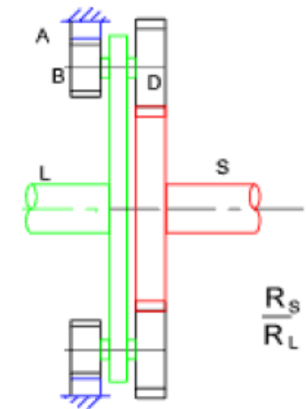
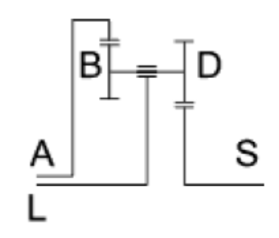




4.2 Epicyclical gears – table method
Rotation of the Shaft L 1 rev CW results in the rotation of the shaft (S) 1 - ( N_{A} . N_{D})/( N _{B} . N _{S}) revs (CW).
Ratio 1: [1 + ( N_{A} . N_{D})/( N _{B}. N _{S})
A fixed
Actions | L | A | B-D | S
Give one CW rotation to whole gear
Fix arm L and rotate A back 1 CCW
Resultant
+1
+1
+1
+1
0
-1
+1
0
Notes:
AENG11301 - Aeronautics and Mechanics
In second row, A is given a -1 rotation to make it fixed at the end (it opposes the +1 rigid body rotation imparted to the whole gear system). Transmission between A and B is positive, multiplied by the -1 of the rotation of A gives – NA/NB. Transmission between S and D is negative (see the sign convention referenced in slide #8) → -ND/NS. This is transmission train, therefore (-NA/NB) x (-ND/NS) = (NA/NB) x (ND/NS)

Slide 16
List of concepts to know
Spur gears - geometry
Kinematics of spur gear trains
Epicyclical gears
Notes:
AENG11301 - Aeronautics and Mechanics

